Slide 1
Digital Ethics
By Patrick McShea

Slide 2

YouTube
Google
(2006)
Statistics:
Approximately 2 billion logged-in monthly users
About 81% of YouTube users are between ages 15-25.
About 15% of the users that use Youtube are located within the United States
About 70% of what people see in Youtube is a direct cause of it’s algorithm
YouTube will make approximately $5.5 billion in revenue from advertising alone in 2020.

Slide 3
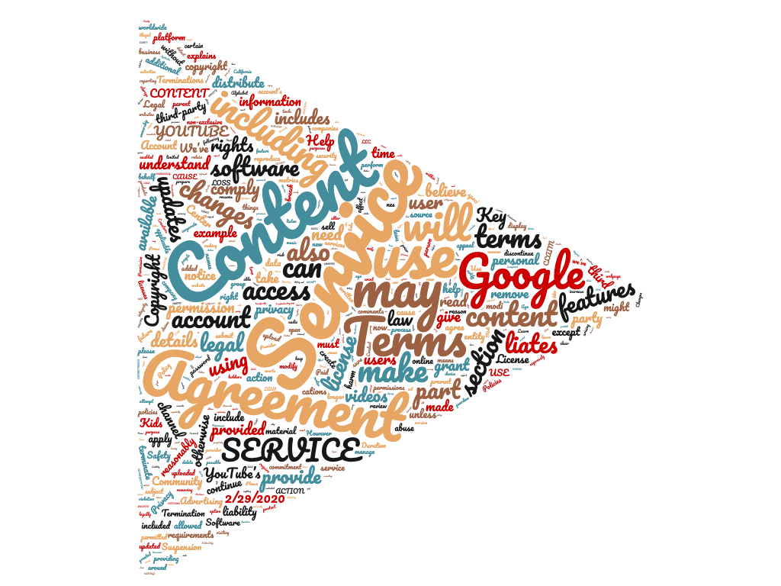
Youtube
Wordcloud:

Slide 4

Snapchat
Statistics:
Approximately 210 million active users daily (as of 2019)
About 90% of all users in the U.S. and 75% are between ages 13-24
Approximately 2.1 million “snaps” are made every minute worldwide.
The average user spends about 26 minutes on snapchat per day.
63% of users say they visit snapchat daily and 49% visit more than once a day.

Slide 5
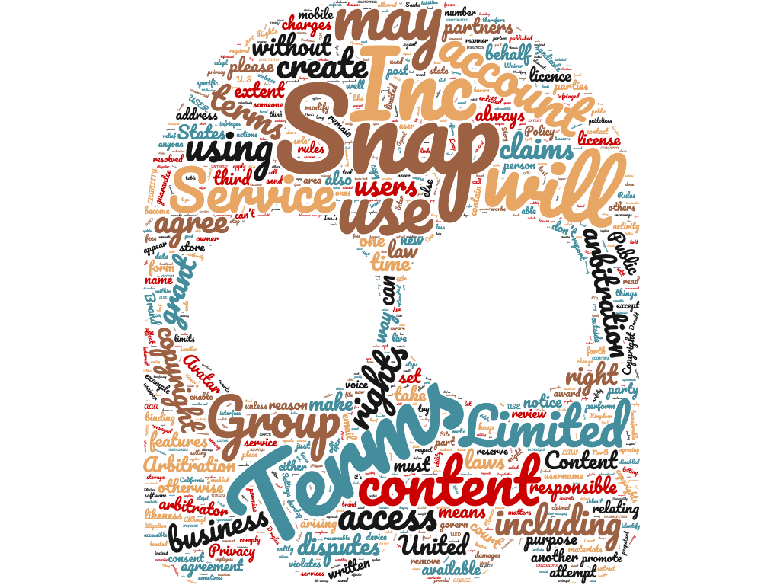
Snapchat
Wordcloud:

Slide 6

Instagram
Facebook
Statistic:
In 2019, there was reported approximately 1 billion active users.
Of the billion users, about 116 million are from the U.S.
About 6 in 10 users login at least once daily.
The average user spends approximately 53 minutes a day on instagram.
Instagram spends 23% more than Facebook on ad spending.

Slide 7
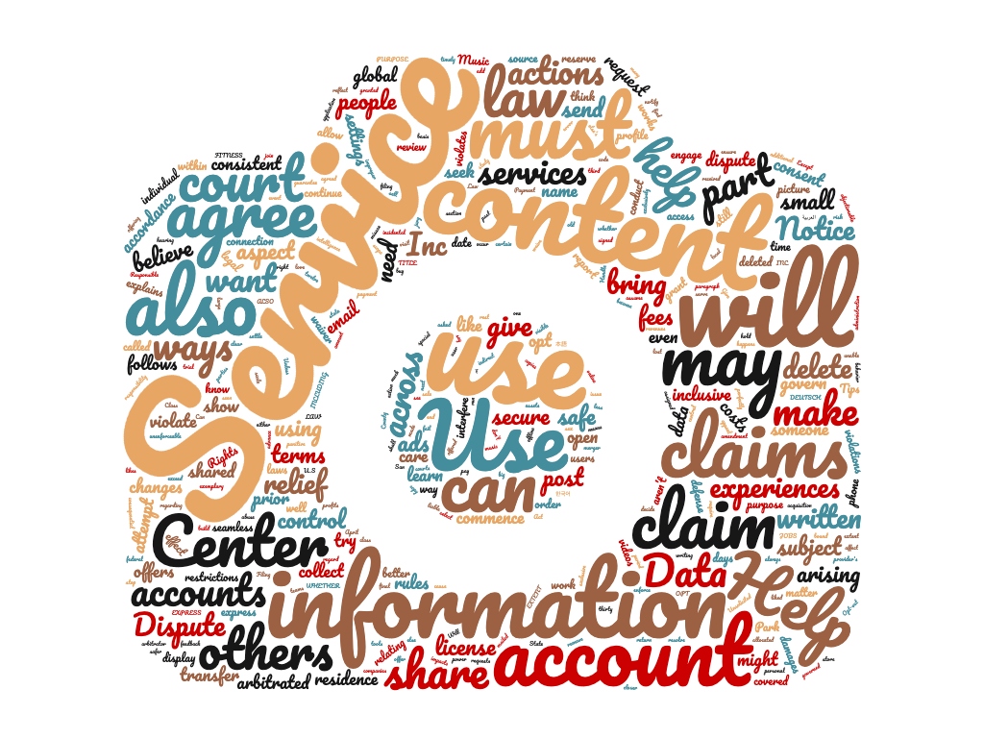
Instagram
Wordcloud:

Slide 8
To conclude:
The ToS may be
worth some attention!
Thanks for listening!
References:
http://wordclouds.com
https://www.snap.com/en-US/terms
https://help.instagram.com/478745558852511
https://www.youtube.com/static?template=terms
https://blog.hootsuite.com/youtube-stats-marketers/#:~:text=1.,1.8%20billion%20in%20May%202018.
https://www.oberlo.com/blog/snapchat-statistics#:~:text=How%20Many%20People%20Use%20Snapchat%3F,the%20second%20quarter%20of%202018.
https://sproutsocial.com/insights/instagram-stats/
https://slate.com/technology/2012/12/instagram-privacy-everyone-s-ignoring-the-real-problems-with-its-terms-of-use.html

Slide 9
Bibliography
“Snap Inc. Terms of Service.” Snapchat. Updated October 31, 2019. https://www.snap.com/en-US/terms.
“Terms of Use.” Instagram. Updated April 19, 2018. https://help.instagram.com/478745558852511.
“Terms of Service.” Youtube. Updated December 10, 2019.
https://www.youtube.com/static?template=terms.
“23 Youtube Statistics that Matter to Marketers in 2020.” Hootsuite. Created December 17, 2019. https://blog.hootsuite.com/youtube-stats-marketers/#:~:text=1.,1.8%20billion%20in%20May%202018.
“10 Snapchat Statistics Everyone Should Know in 2020.” Oberlo. Created December 3, 2019. https://www.oberlo.com/blog/snapchat-statistics#:~:text=How%20Many%20People%20Use%20Snapchat%3F,the%20second%20quarter%20of%202018.
“Important Instagram Stats You Need to Know for 2020.” SproutSocial. Created January 23, 2020. https://sproutsocial.com/insights/instagram-stats/.
“Everyone is Ignoring the Much Bigger Problems With Instagram’s New Privacy Policy.” Slate. Created December 19, 2012. https://slate.com/technology/2012/12/instagram-privacy-everyone-s-ignoring-the-real-problems-with-its-terms-of-use.html.

